Slide 1
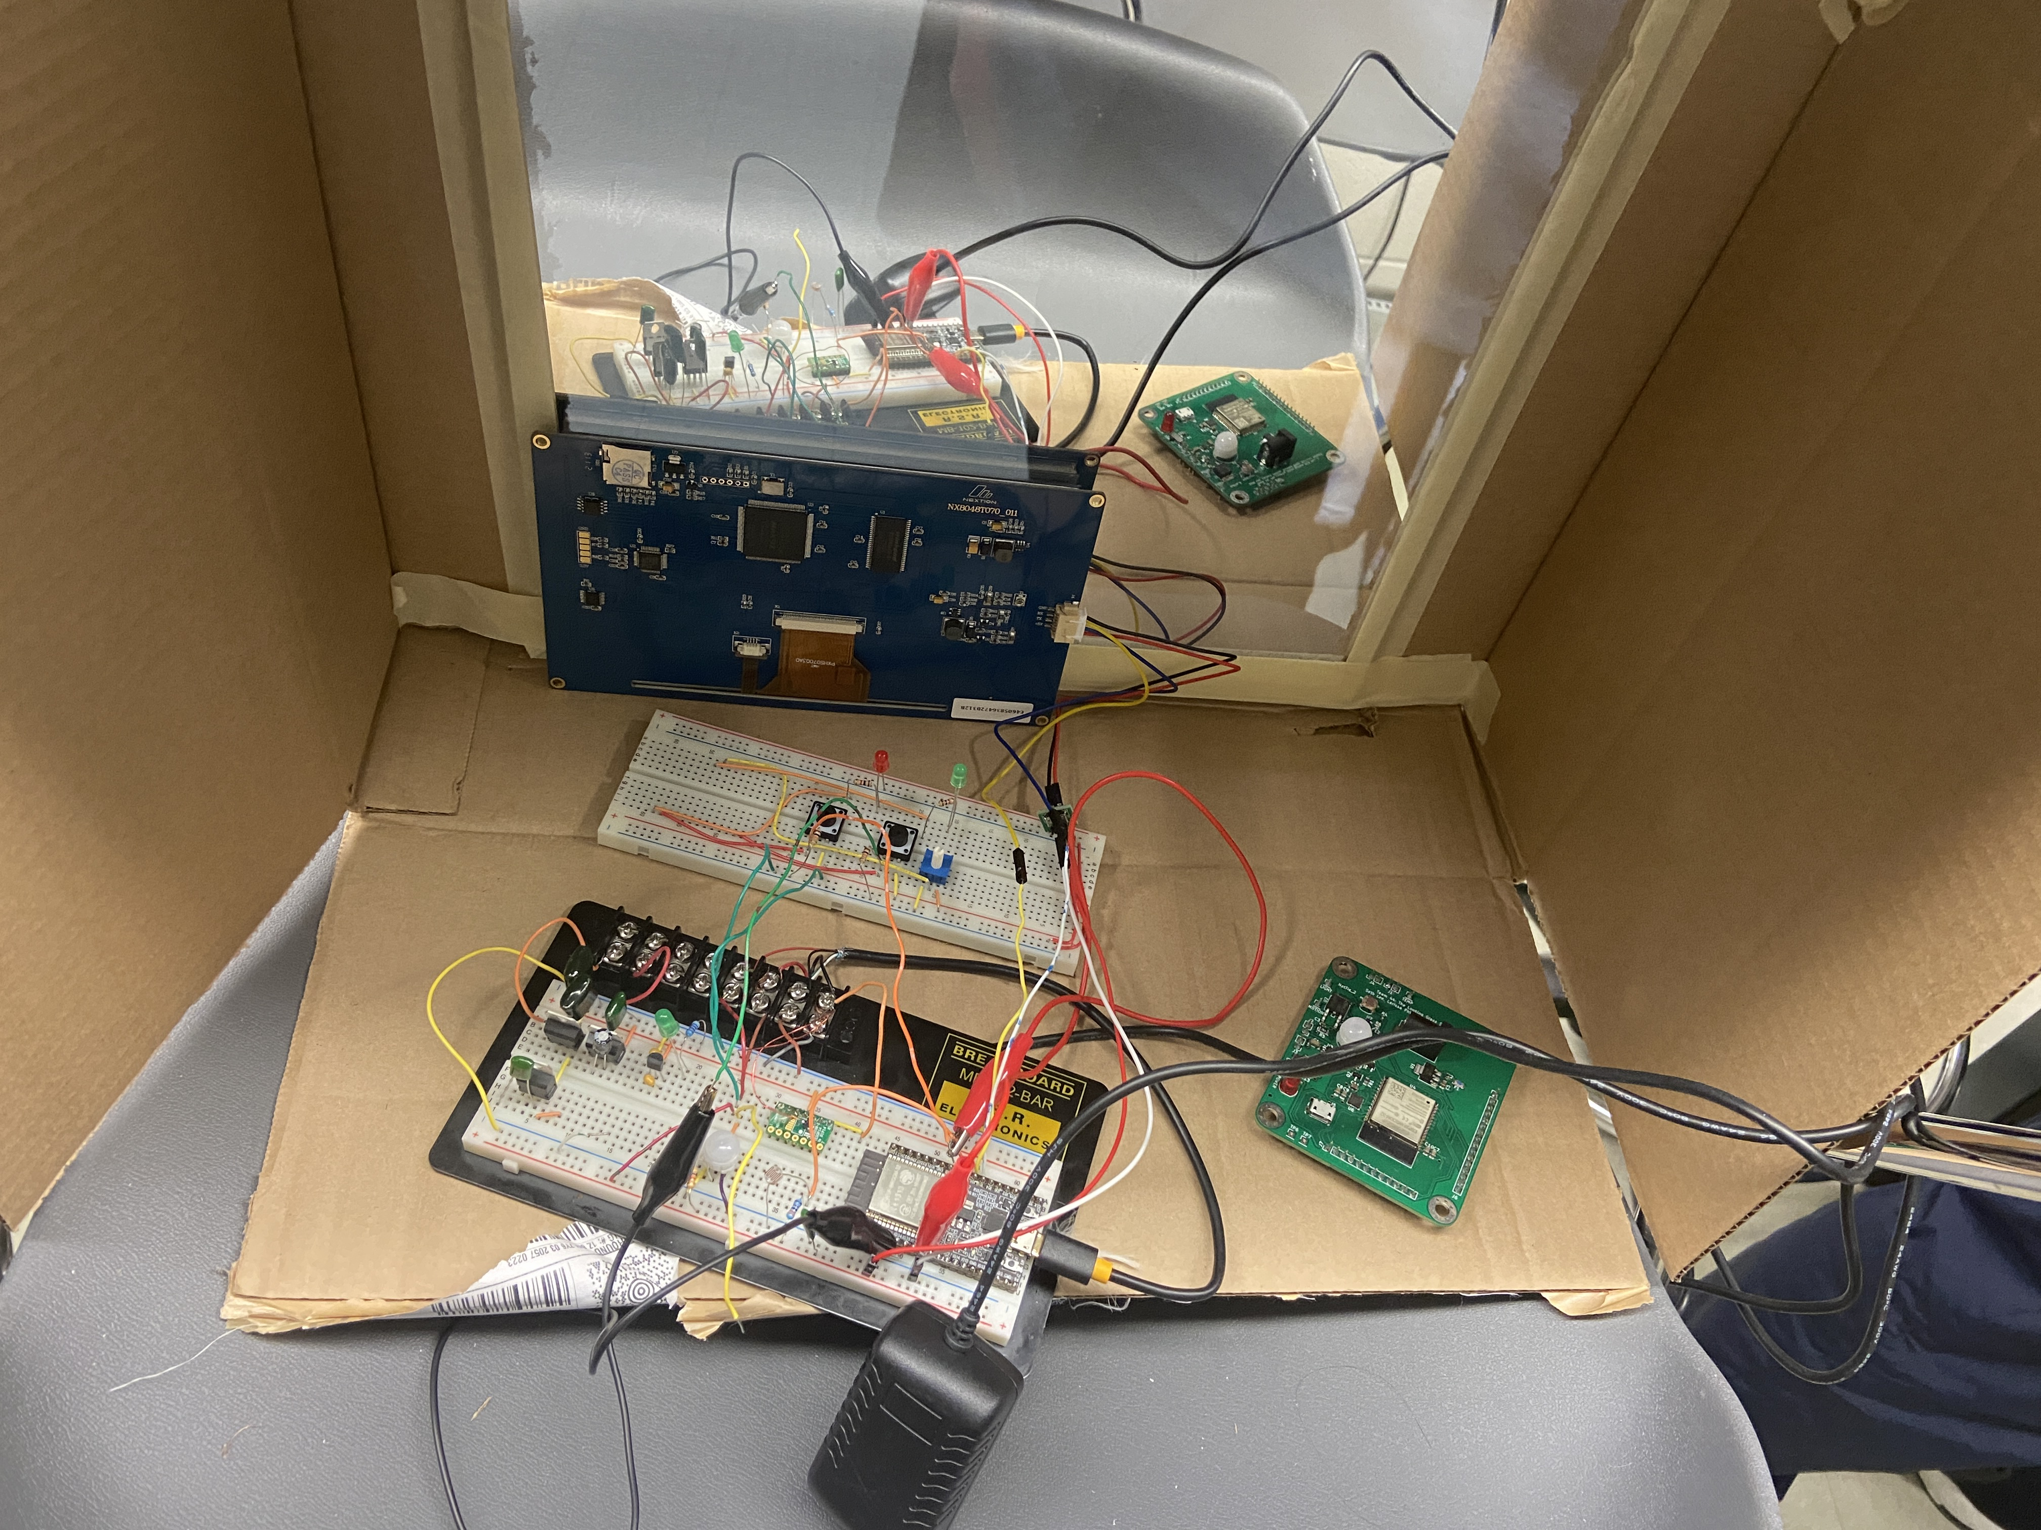
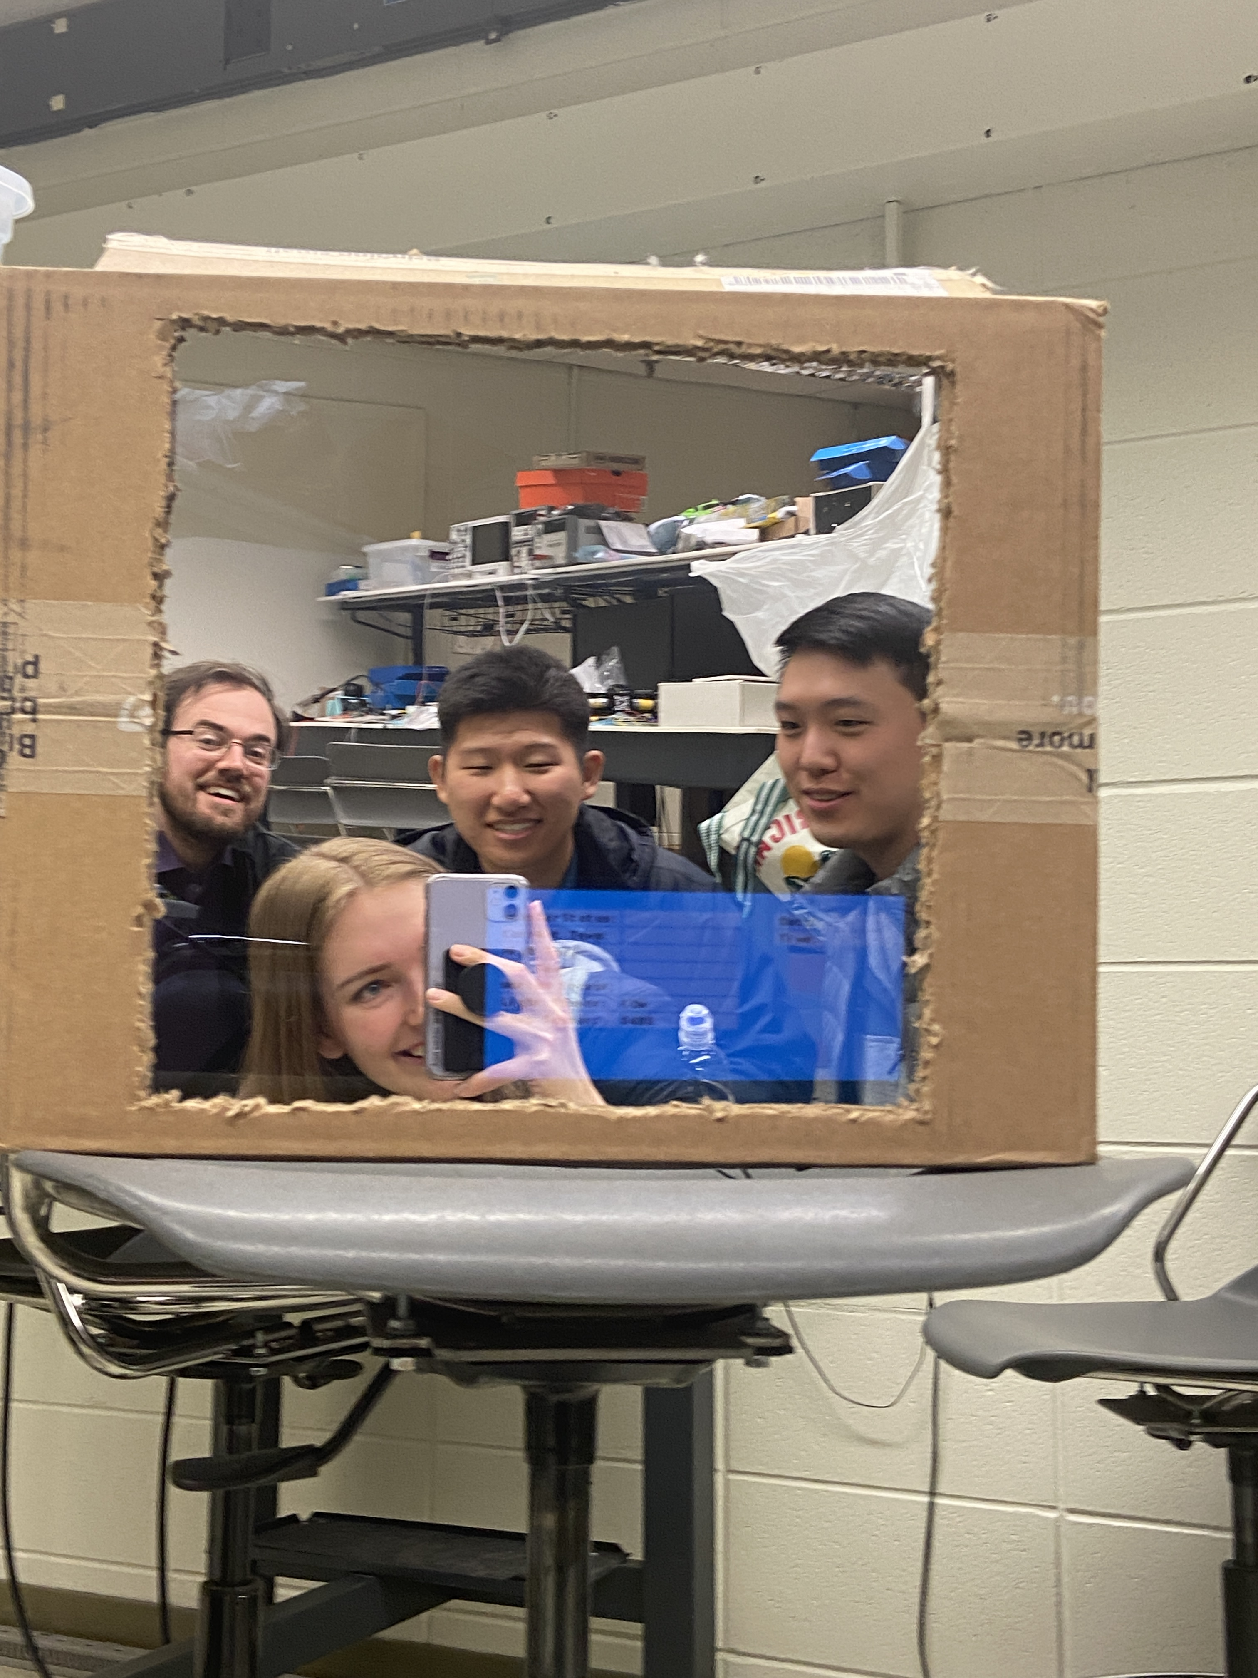
The Looking Glass
Larissa Phillip, Richard Rhee, Seth Lee, Nicholas Schuch
The Looking Glass is a smart mirror designed to decrease the amount of time spent on our phones in the morning, and provide a one-stop quick look at the day ahead. The smart mirror has a low power mode, and activates via motion sensors to display notifications, daily weather and top news stories.

